Slide 1
UTK Class Scheduling Assistant
David Long, Ethan Miller, Gian Fernandez, Lexy Andershock and Tatiana Dehoff

Slide 2

Introduction
Our project aims to create a system that can:
automatically schedule classes based on location or time
consider previous + current coursework
save time and headaches!

Slide 3





Features
Previous Coursework Survey
Regenerate Button
Save Schedule Button
User Login/Registration
Schedule UI

Slide 4
Back End
1000+ lines of C++ code
Course info from .csv (name, lab + lecture info, pre-reqs, etc.) stored into structs
List of untaken classes is generated from the course survey
Location:
Creates 2D vector of distances (in miles) between two buildings
Filters courses by pre-req satisfaction and credit hours
Finds sections that are geographically adjacent and no time conflict
Time:
Uses user-specified start time, gap time, and credit hours to create a priority queue
Checks pre and co-reqs
Schedules the class with the highest priority and no time conflicts
Prints course IDs to terminal

Slide 5

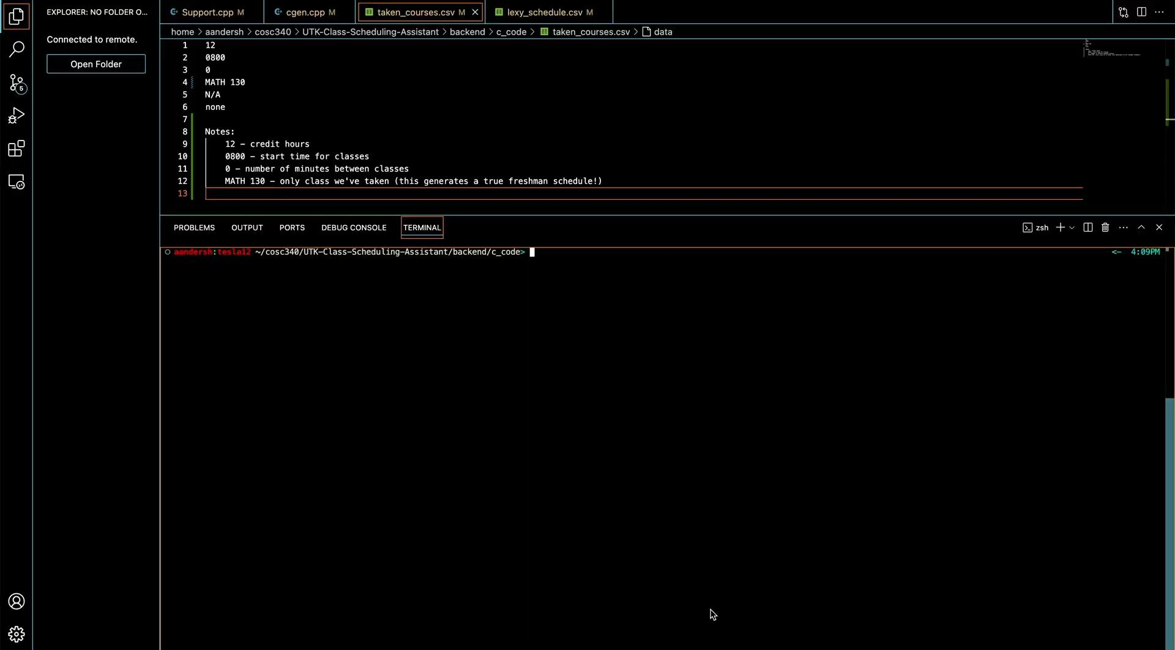
Back End Showcase!
Location Demo
Time Demo

Slide 6
Now for the demo!

Slide 7
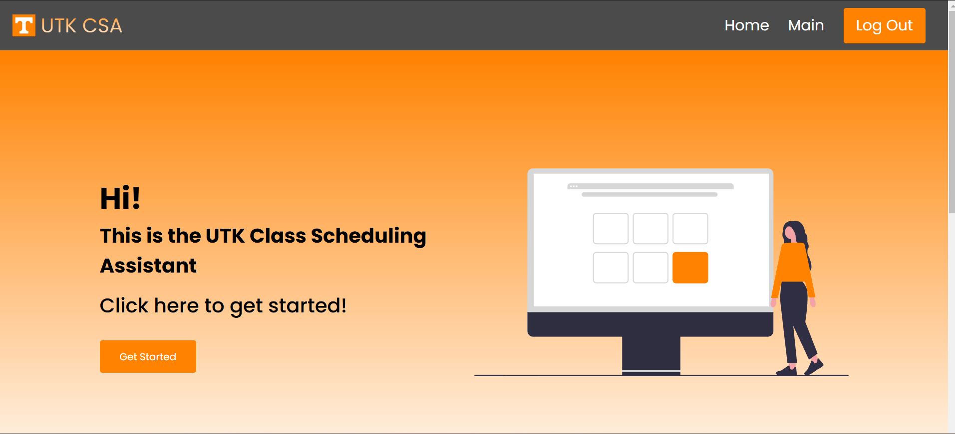
Home Page
Notes:
Used HTML/CSS to design website

Slide 8
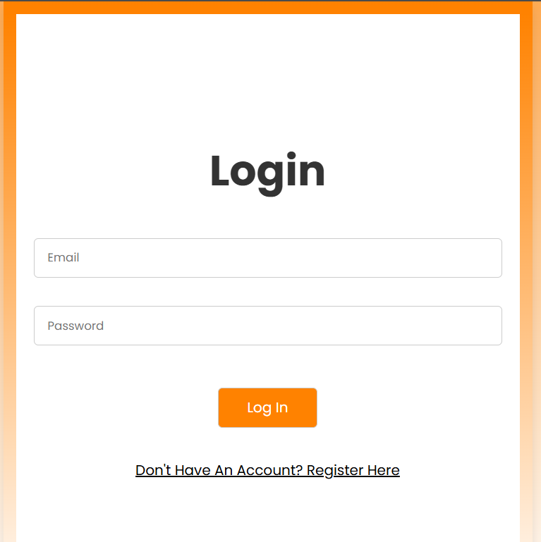
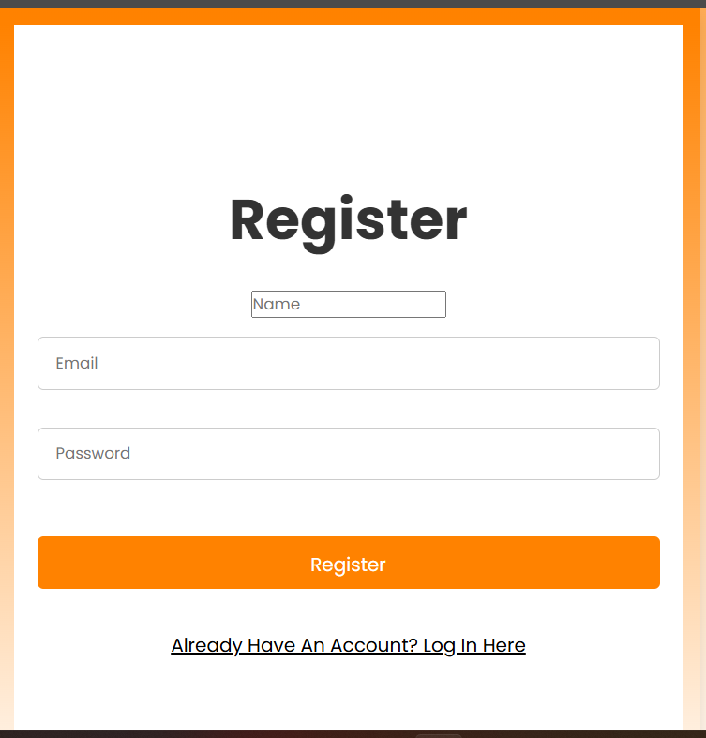
Login/Register Page
Notes:
Used HTML/CSS to design website

Slide 9
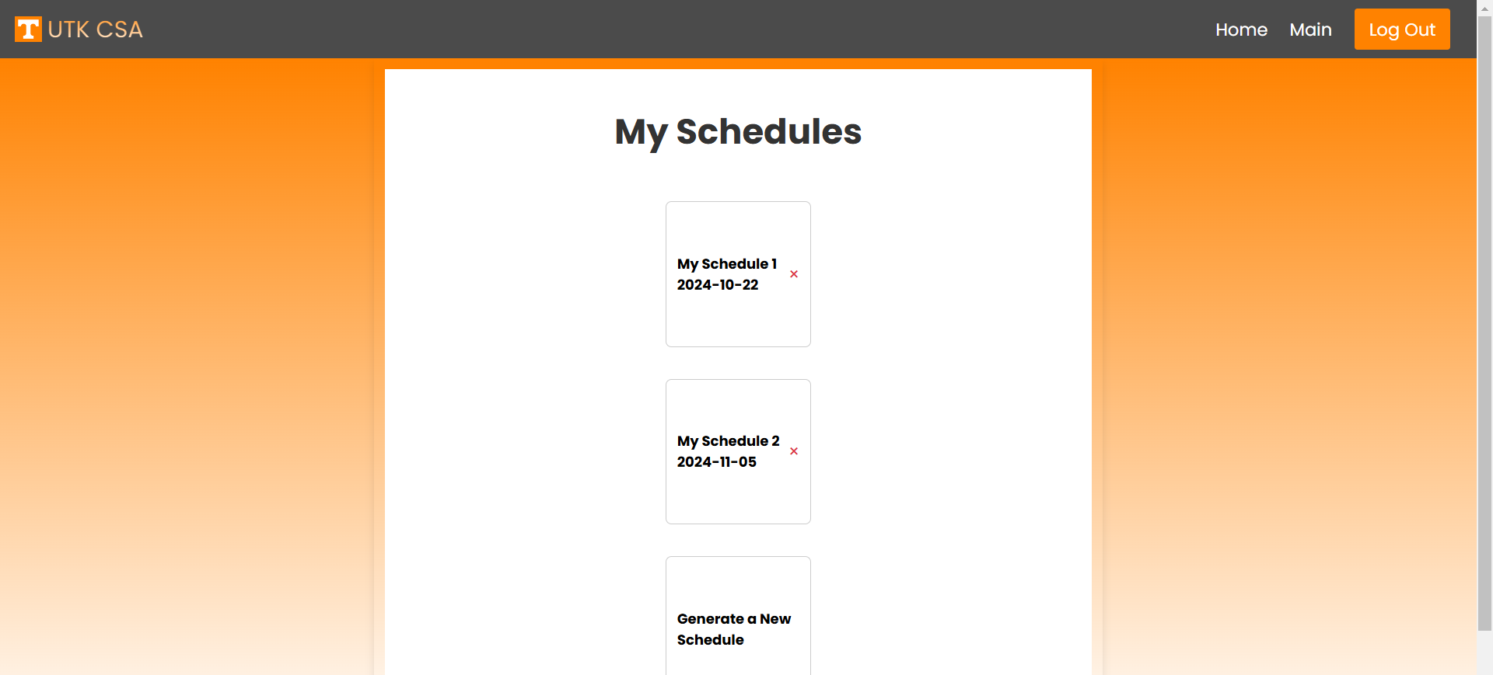
Main Page
Notes:
Used HTML/CSS to design website

Slide 10
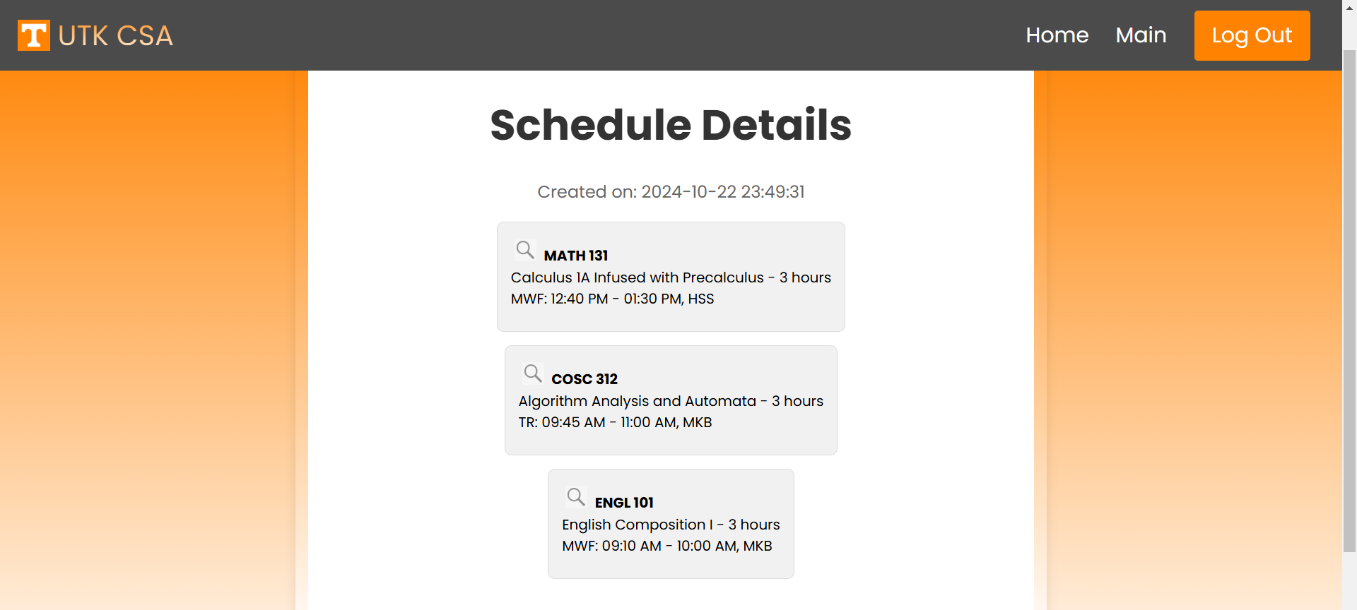
Schedule Details Page
Notes:
Used HTML/CSS to design website

Slide 11
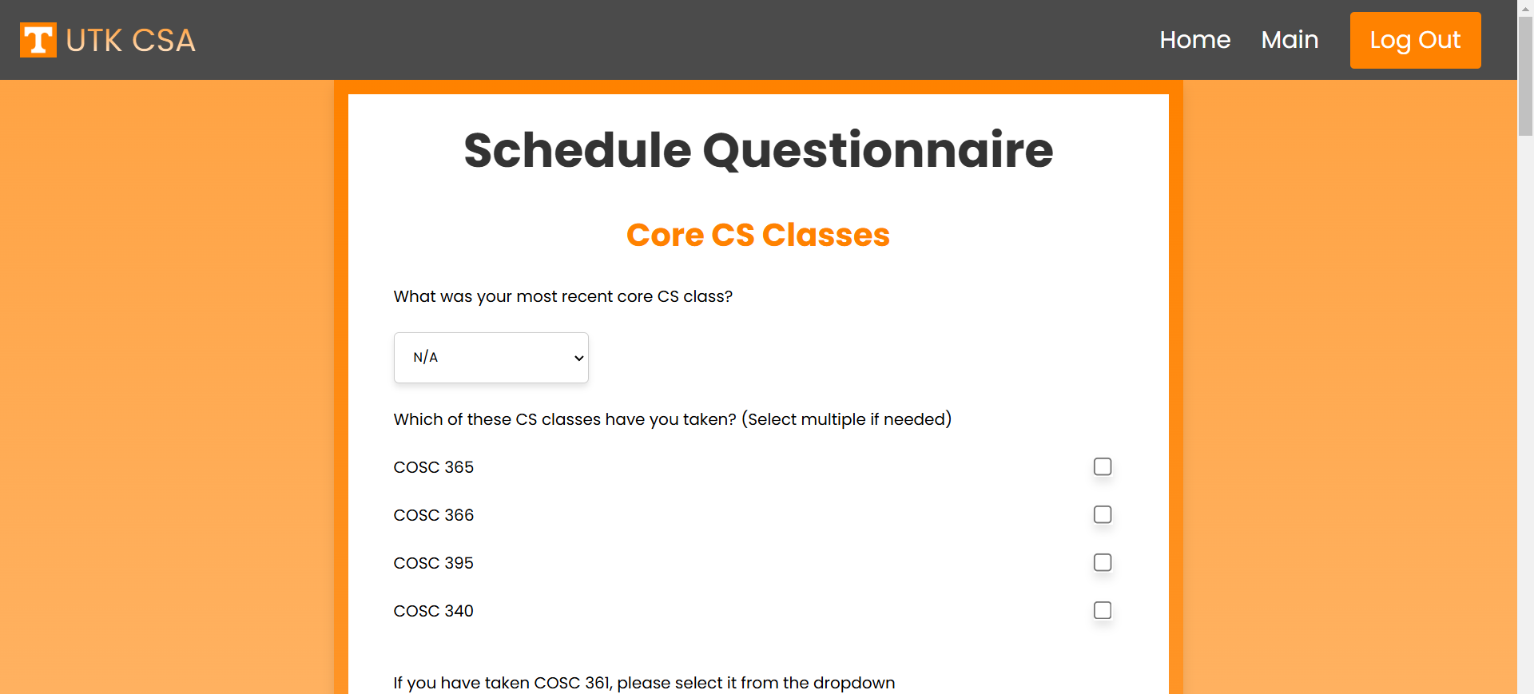
Schedule Questionnaire Page
Notes:
Used HTML/CSS to design website

Slide 12
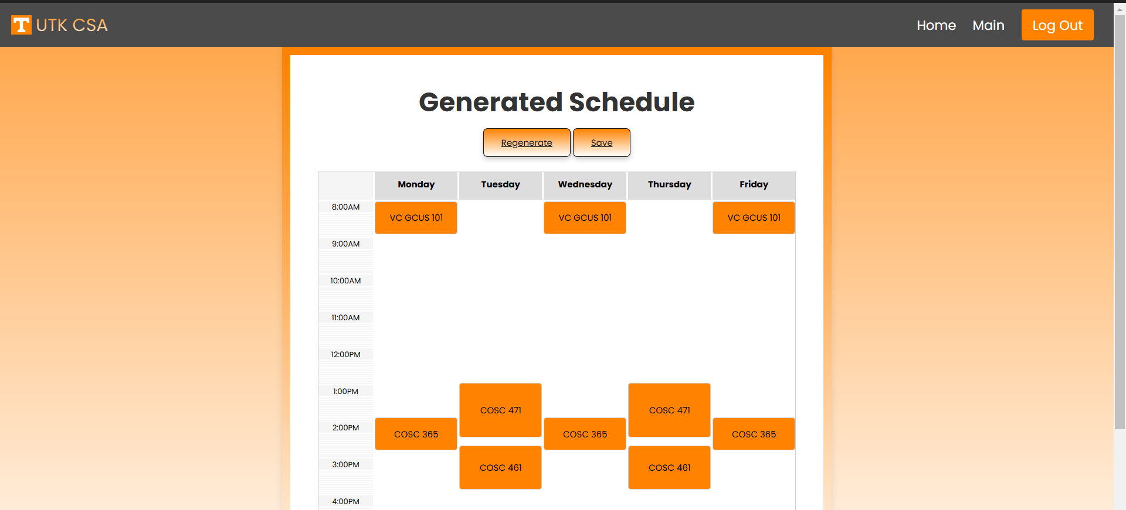
Generated Schedules Page
Notes:
Used HTML/CSS to design website

